Slide 1
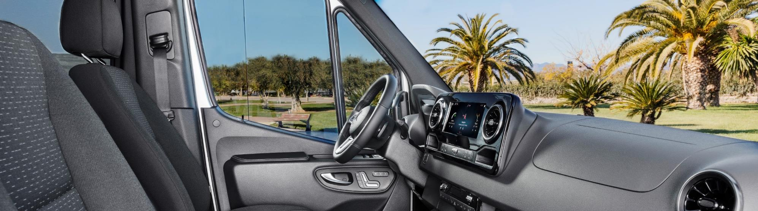
Sprinter product training motorhomes
RM spezifisches Bild einfügen

Slide 2
100 % FOR YOU! The new Sprinter.
SAFETY
FLEXIBILITY
COMFORT
PAYLOAD
CONNECTIVITY
BODYBUILDER-
FRIENDLY
RELIABILITY
PREMIUM
QUALITY

Slide 3
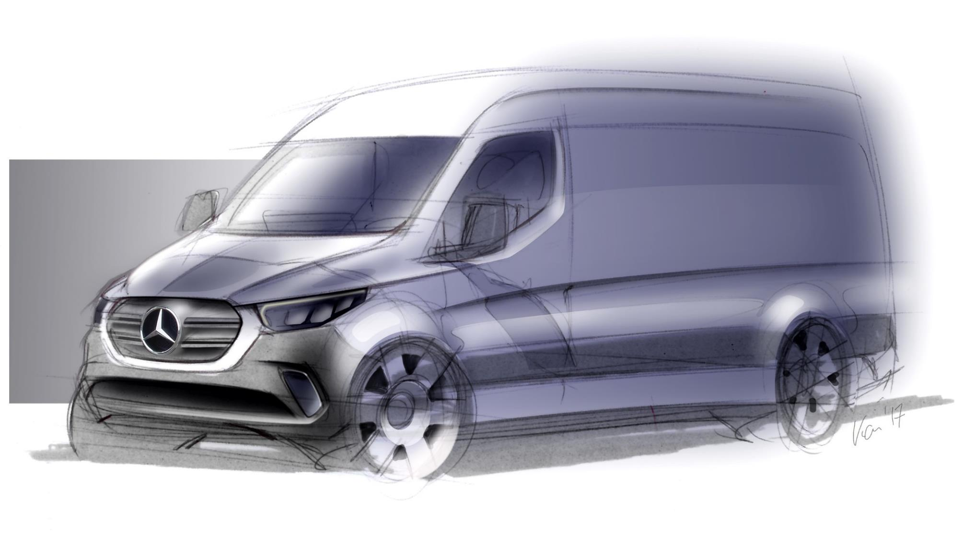
Design

Slide 4
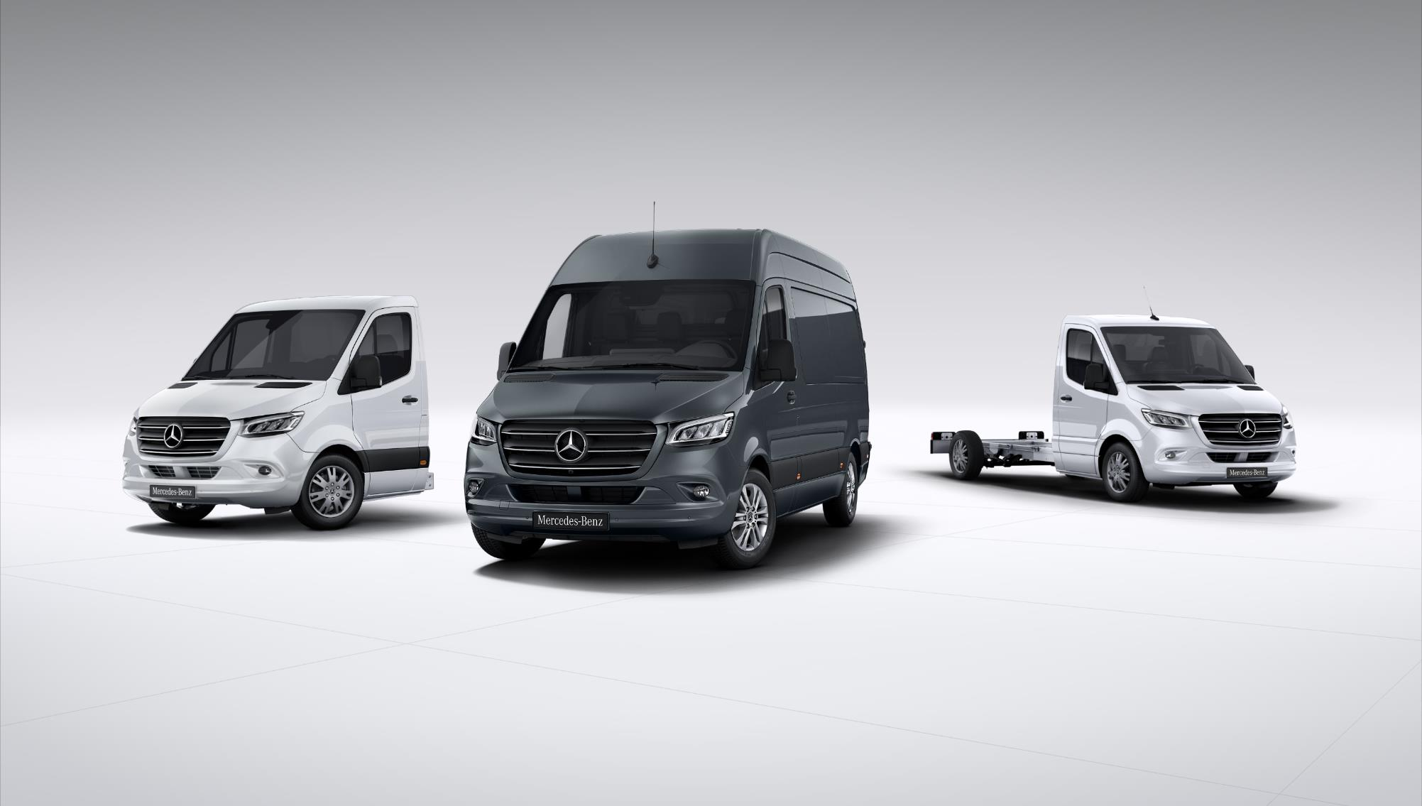
100 % FOR YOU! The new Sprinter.
Notes:
Botschaft: der neue Benchmark für Camper Van´s / RV
Prämisse: der neue Sprinter bietet zahlreiche weitere Varianten und Möglichkeiten, der Vortrag fokussiert sich auf die branchenspezifischen Schwerpunkte

Slide 5
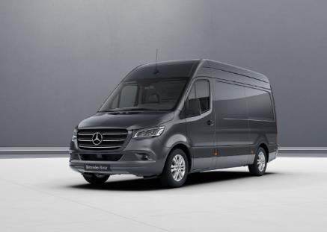
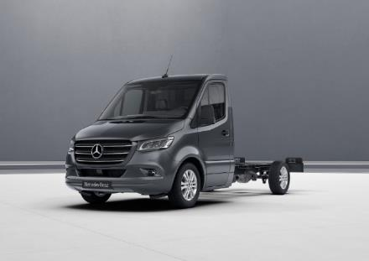
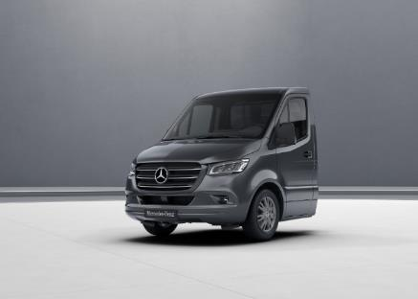
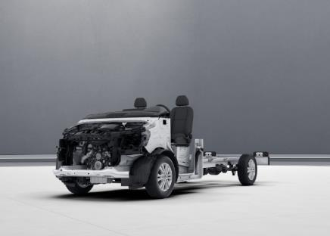

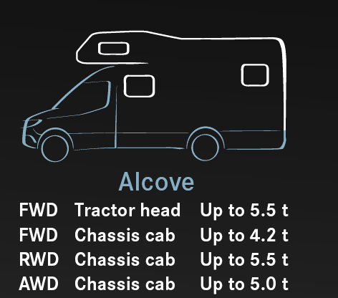

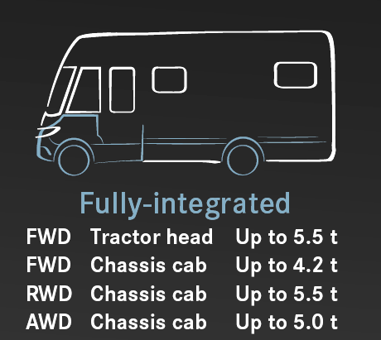
Product highlights – Range
Panel Van A2LH2
(1x RWD +1x FWD)
Chassis A2
Tractor Head
Cowl

Slide 6



100 % FOR YOU! The new Sprinter.

Slide 7
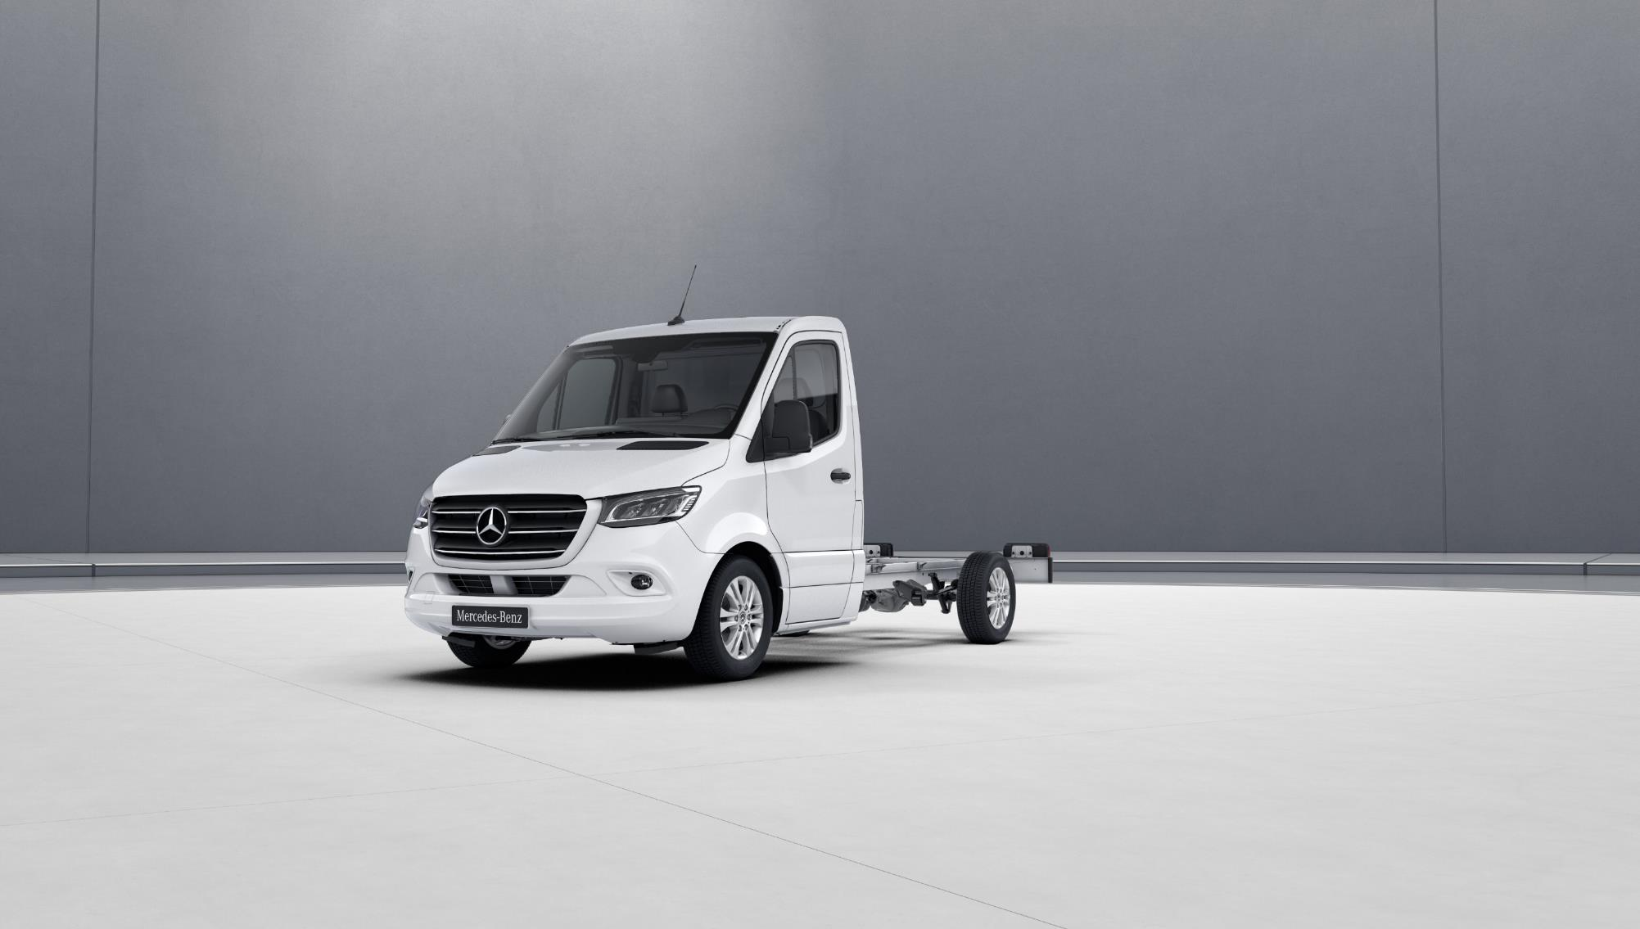
Product highlights – Exterior

Slide 8
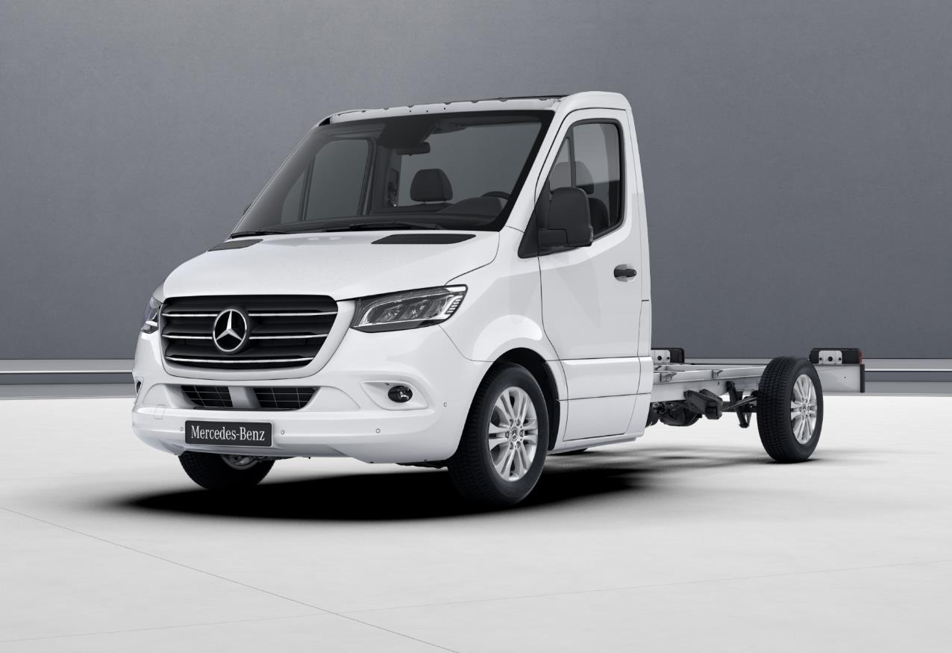
Product highlights – Exterior
Chassis with cab base and doors (F28)
+ if necessary cab roof lowered (FA1)
Camera and sensor assistence systems
Heat-insulating glass with filter brand on windscreen (H21)
Power-folding side mirrors (F64)
New front design
LED High Performance headlamps (LG7)
Tail lamps with (partial for panel van) LED technology L22
Chrome-plated radiator grille (FK3)
Radiator grille frame in vehicle colour (CN2)
Fog lamps with cornering light function (L13)
16” & 17” alloy wheels
Active Distance Assist DISTRONIC (ET4)
Bumpers and detachable parts painted in vehicle colour (CM2)

Slide 9
Product highlights – Interieur

Slide 10
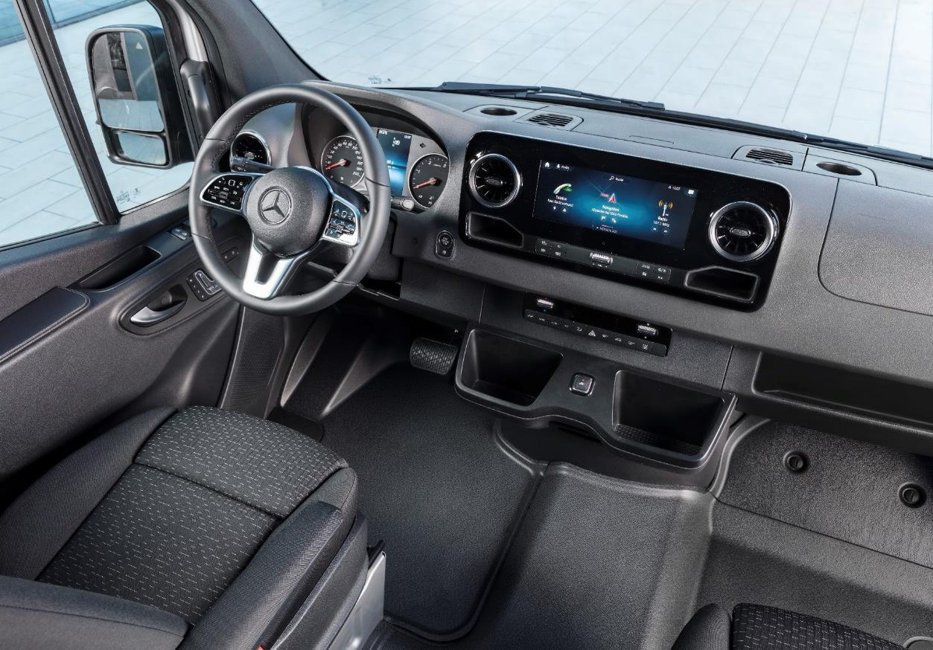
Product highlights – Interieur
Multifunction steering wheel (C6L):
Operation MBUX, Distronic & Tempomat
Leather steering wheel (CL3)
Hinged lid for stowage compartments (FJ1+FJ5)
Power-folding side mirrors (F64)
Side mirrors, heated and power-adjustable (F68)
MBUX multimedia system 7“ (E3M)
MBUX multimedia system 10,25“ (E4M) with touchscreen
Driver‘s & co-driver‘s seat power-adjustable with memory function (SF1 + SF2)
Control Panel under MBUX for additional operation Multimedia
Armrest, driver‘s and co-driver‘s door (S28)
Armrests (S22 + S25)
THERMOTRONIC automatic climate control system (HH4)
TEMPMATIC semi-automatic climate control system (HH9)
Swivel frame for driver’s ans co-driver’s seat (SR8 + SR9)
Luxery driver‘s seat & comfort co-driver‘s seat (SB1 + SB2)
Lumbar support (SE4 + SE5)
Additional Stowage compartment and Cupholder selectable
Free way through:
Electric parking brake (B25)
Notes:
PKW-Wertanmutung
„Welcome home“ feeling

Slide 11
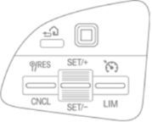
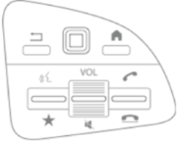
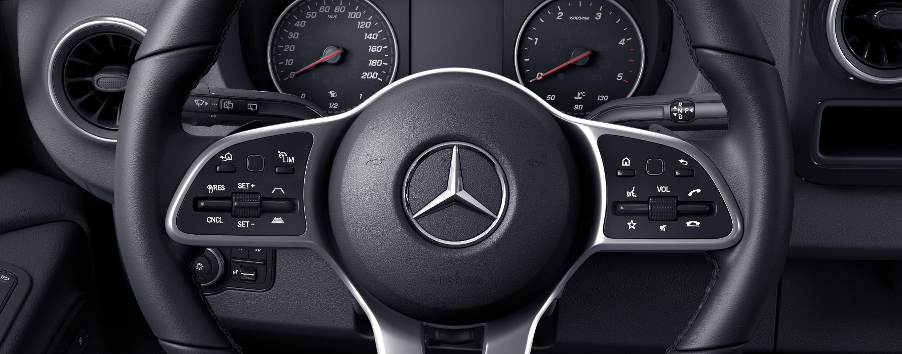
Operation via the multi-function steering wheel
operation of the instrument cluster via control panel on the left
operation of the multimedia system via control panel on the right
CRUISE CONTROL/
DISTRONIC control buttons

Slide 12

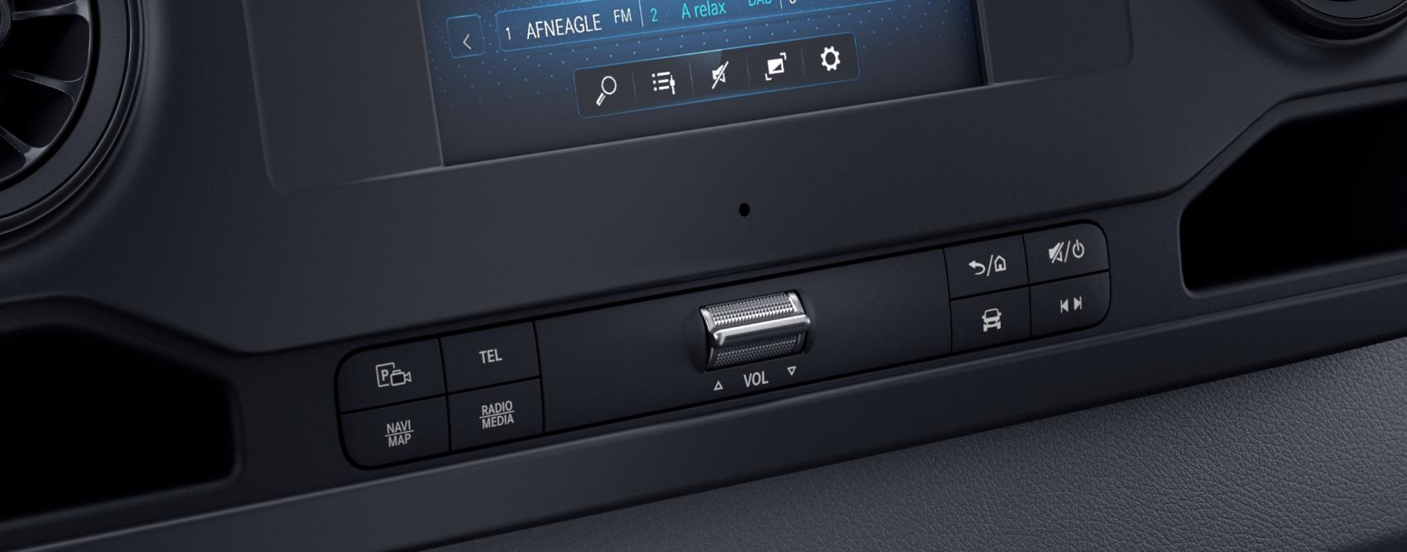
Control with buttons below the touchscreen display
back button/
home menu
telephone menu
mute/
power button
reversing camera/
360° camera
audio menu
navigation menu
vehicle settings
radio and media menu

Slide 13
MBUX
Mercedes-Benz User Experience

Slide 14
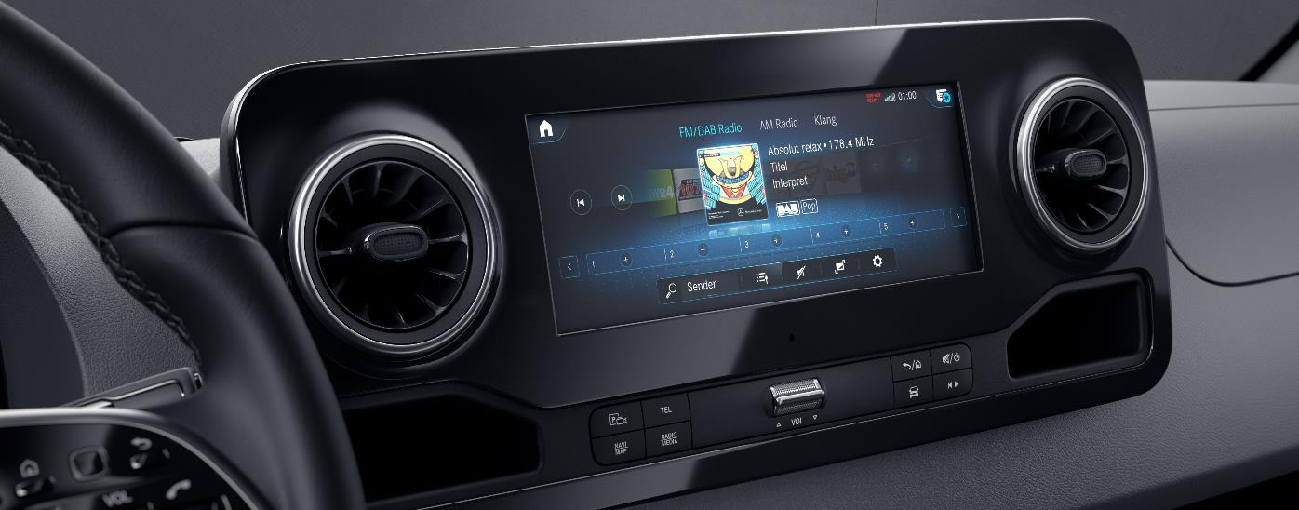
MBUX (Mercedes-Benz User Experience) highlights in combination with Navigation (E1E/E4M)/ Satellite radio (E1S) and Communication module (JH3)
Voice control with natural speech recognition
updates
"over the air"
personalisation
messages menu
ability to learn thanks to artificial intelligence
smartphone integration*
(Apple CarPlay™ and Android Auto)
"What3Words" navigation
hotspot functionality in the vehicle
*) also possible without navigation (E1E/E4M)/ satellite radio (E1S) and communication module (LTE)

Slide 15
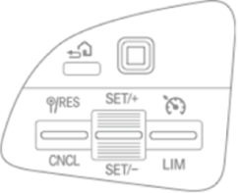
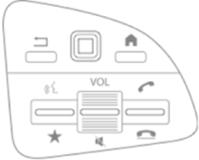



The MBUX system can be operated via…
multi-function steering wheel
touchscreen
control buttons below the touchscreen display
voice control ("Hey Mercedes")

Slide 16
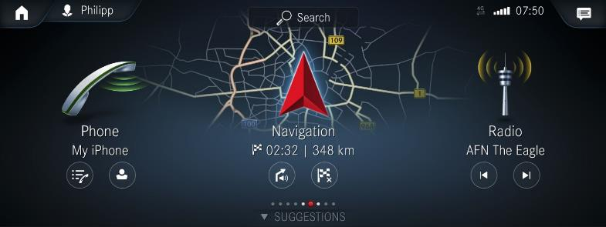
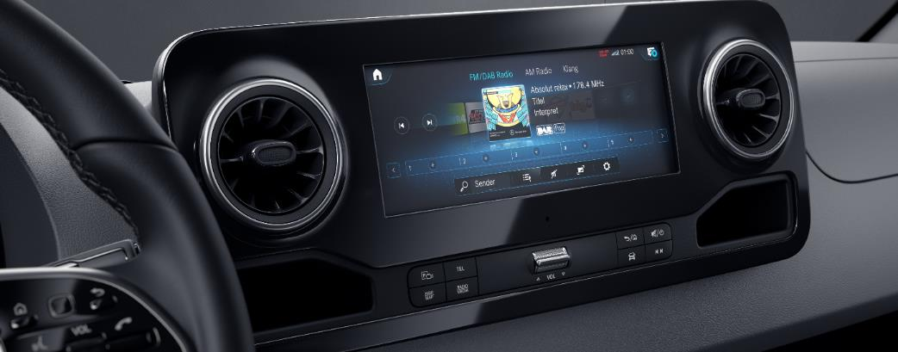
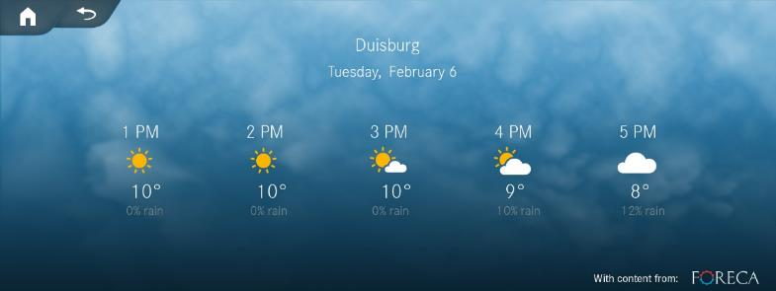
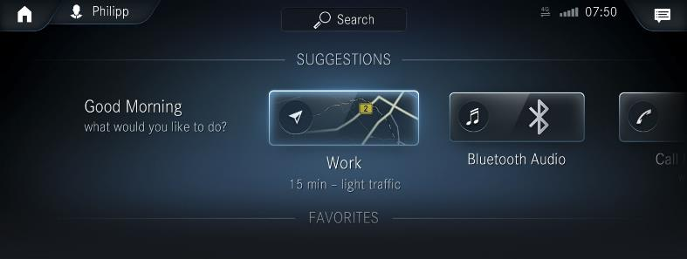
Das MBUX System – operation modes

Slide 17

Operation via voice control "Hey Mercedes"* - Examples
  Car options:
    "Hey Mercedes, turn on the heated seats."
  Internet information + weather information
    "Hey Mercedes, what's the weather like in Porto?
  navigation:
        "Hey Mercedes, what's the address of Camping Campidouro in Porto?“
        "Hey Mercedes, how long till we reach our destination?"
        "Hey Mercedes, take me to looked.digits.paving."
  title search + radio stations
        "Hey Mercedes, find the station FluxFM.“
        "Hey Mercedes, play Janis Joplin - Mercedes-Benz for me. “
  contact linking + calling, text messages
        "Hey Mercedes, read the last text message from my daughter.“
        "Hey Mercedes, send a text message to my children that we‘ve arrived in Porto.“
*) Vehicles without a communication module (JH3) fitted have a limited scope of functions

Slide 18


Slide 19

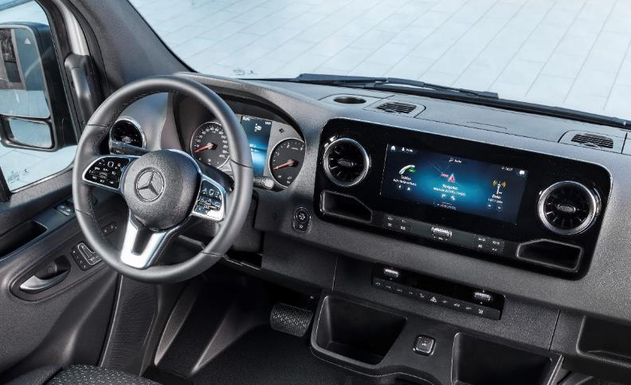
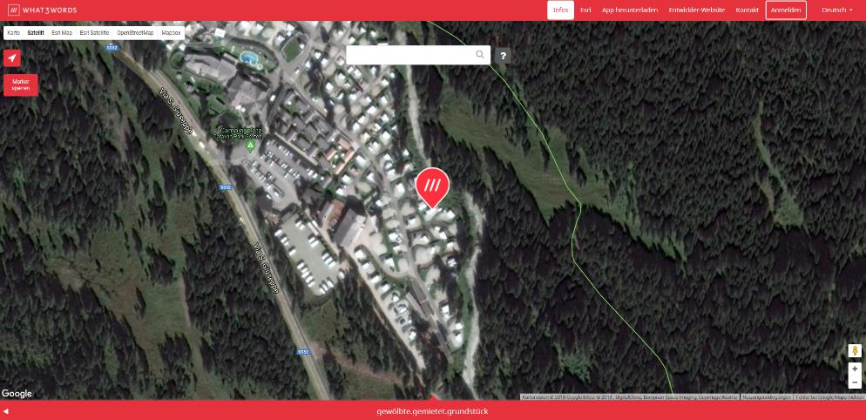
Product highlights –WHAT3WORDS
    → Find your parking space at the campsite easily:
    "Hey Mercedes, drive me to honeycomb.hails.blessings “
Camper UseCase

Slide 20
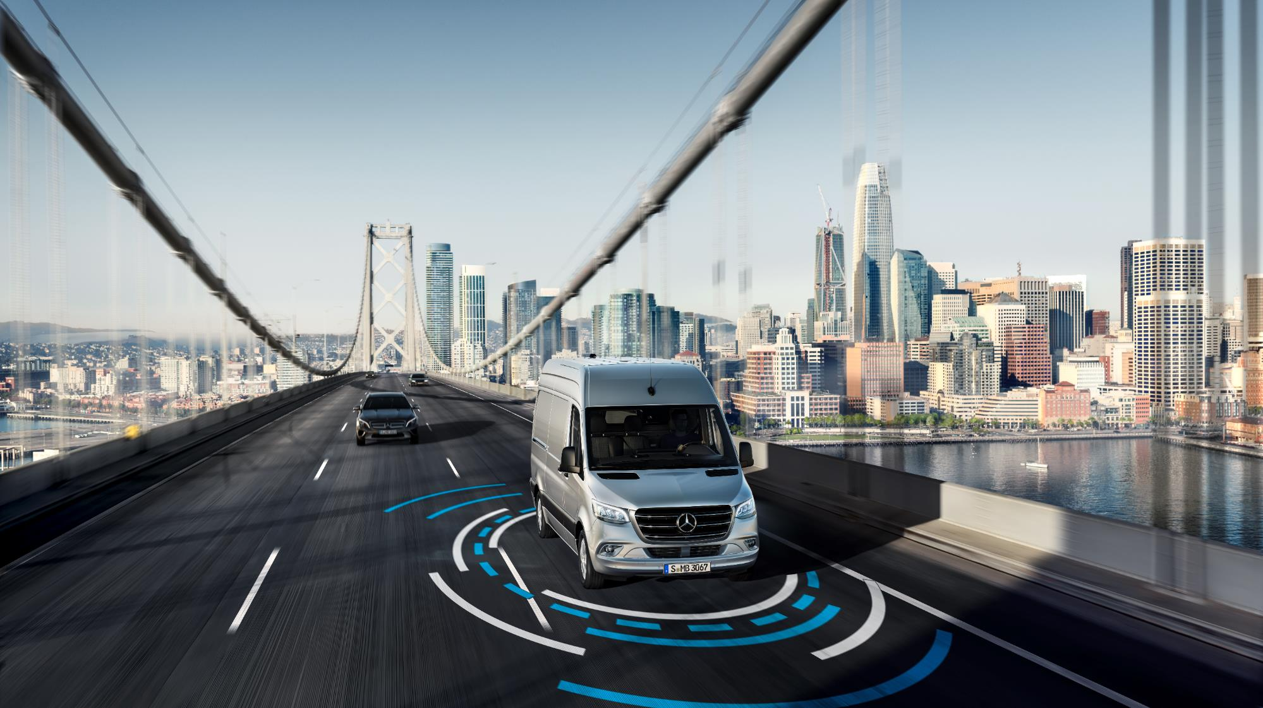
Product highlights – safety & comfort

Slide 21
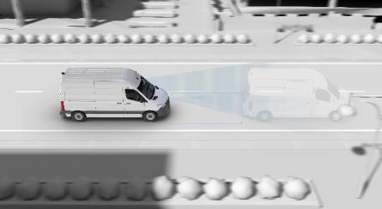



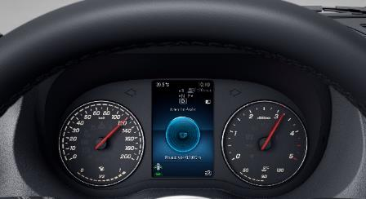
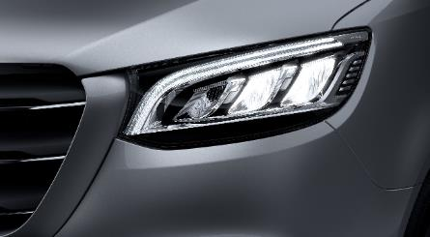





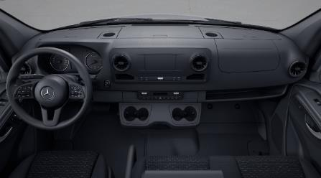
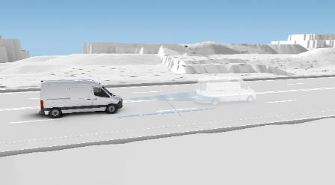

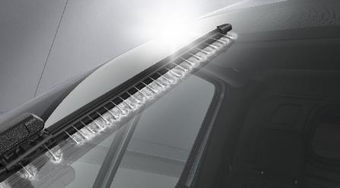
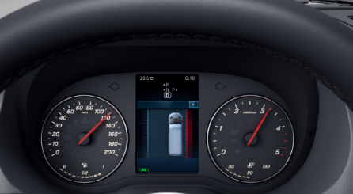
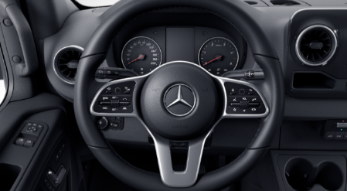
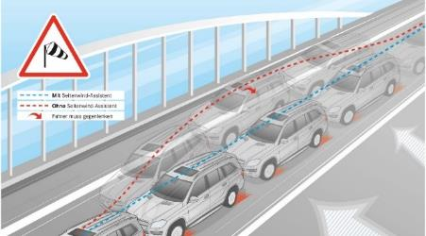


Sight and light
Active support in critical situations
Comfort and safety during long trips
Headlamp Assist (LA2)
Active Brake Assist (BA3)
Attention-Assist (JW8)
Highbeam Assist (LA1)
Driver and co-driver airbag
(SA5 + SA6)
Active Distance Assist
DISTRONIC (ET4)
Rain sensor (JF1) with WET WIPER SYSTEM (FM3)
Active Lane Keeping Assist (JB4)
Cruise control (MS1) &
Hill-Start Assist (E07)
Crosswind Assist (JA8)
available individually reviewed
Notes:
Parking Package with reversing camera / 360° camera
Berganfahrhilfe

Slide 22
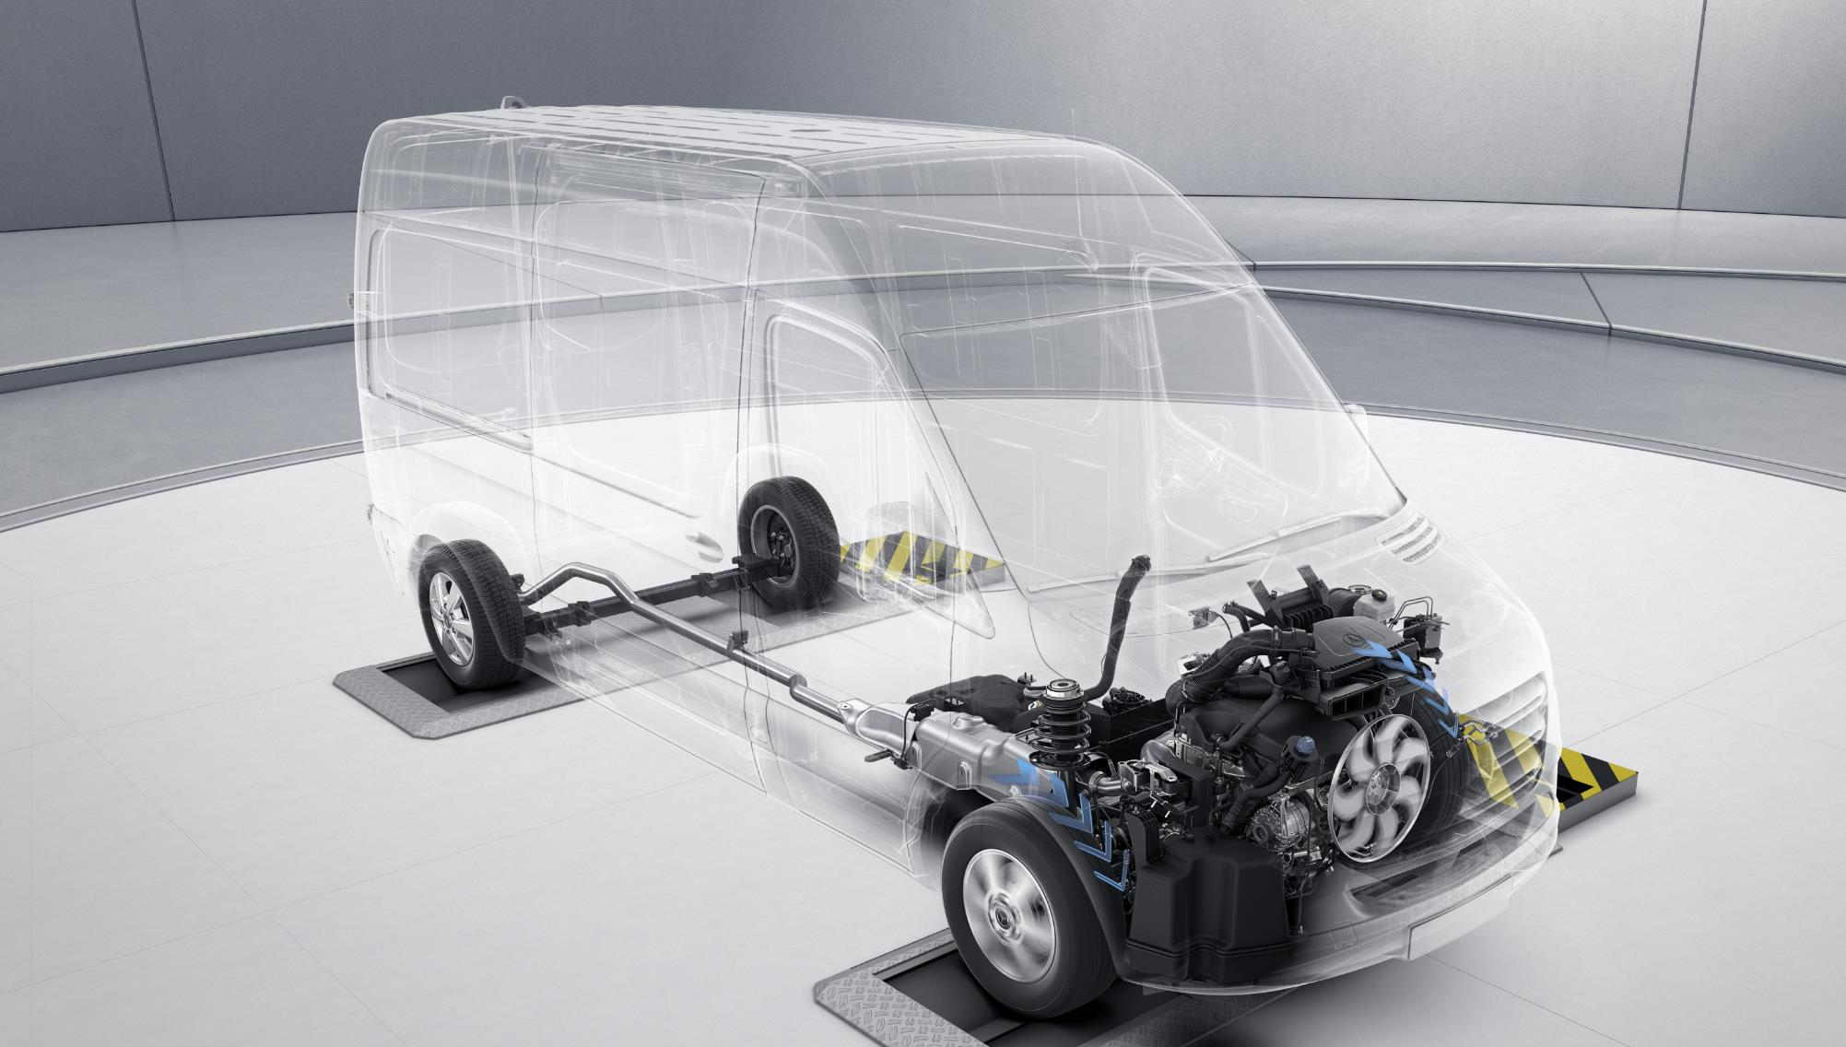
Product highlights – powertrains & engines
Notes:
Inkl. Abgas Systeme: Botschaft: das Neueste was es gibt

Slide 23
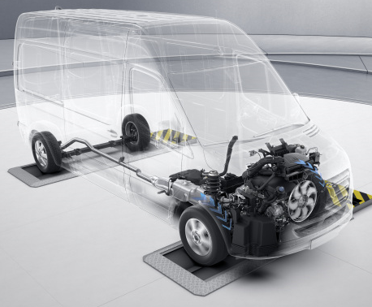
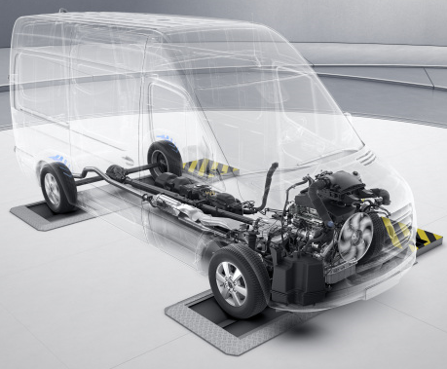
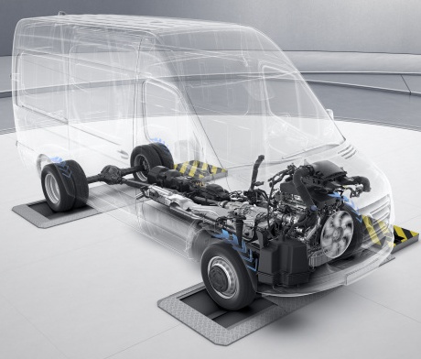
Product highlights – powertrains & engines
Front-wheel drive (FWD)
Rear-wheel drive (RWD)
Engageable all-wheel drive(AWD)
Notes:
Inkl. Abgas Systeme: Botschaft: das Neueste was es gibt

Slide 24



Engine overview - Diesel
RoW
4x4 like NCV3 (Euro V and VI)
NEW
NEW
 | FWD | RWD | RWD | RWD
6 cyl. OM642 |  | Euro VI
4 cyl. OM651 | Euro 6 | Euro 6/VI | Euro III | Euro V
140 kW
440 Nm
130 kW
400 Nm
120 kW
360 Nm
110 kW
330 Nm
120 kW
360 Nm
105 kW
330 Nm
105 kW
330 Nm
Manual gearing
84 kW
300 Nm
84 kW
300 Nm
84 kW
300 Nm
84 kW
300 Nm
Manual gearing/
Automatic gearing
= only for RVs, not displayed in regular pricing list
Motor Portfolio bis 2021

Slide 25
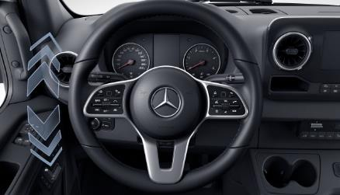
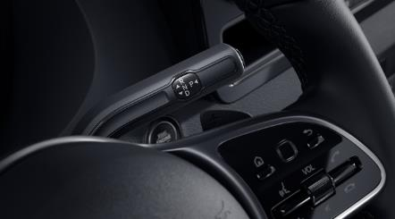
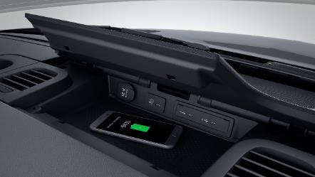
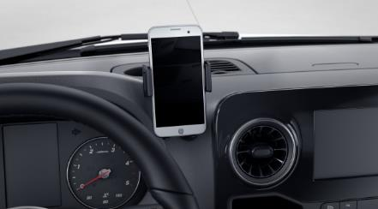
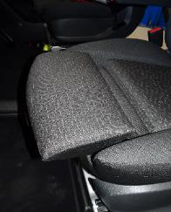

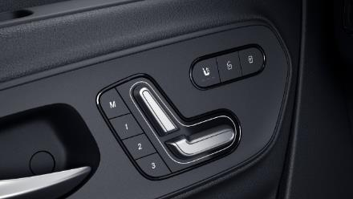
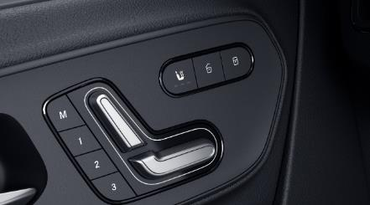
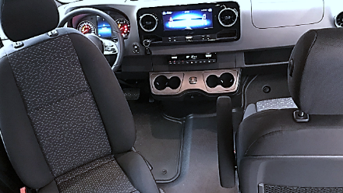
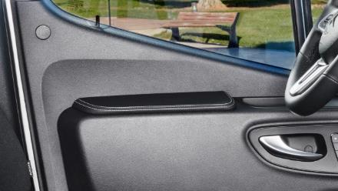
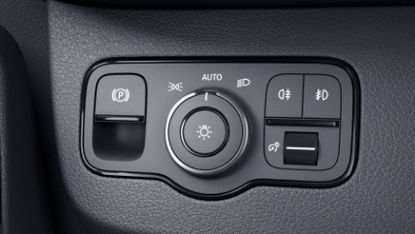
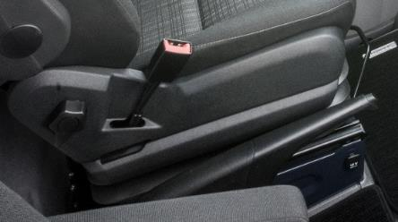

Product highlights – Camper specific options
Comfort leather steering wheel (C6L+CL1+CL3)
9G-Tronic FWD (GK8)
Stowage compartment for smartphones with wireless charging (E1B)
Smartphone holder (E11)
Comfort seats (SB1+SB2 with „AGR“ kite mark) & lumbar support (SE4+SE5)
Power driver‘s and co-driver‘s seat (SF1 + SF2)
Seat heating (H15+H16)
Swivel frame for driver‘s and co-driver‘s seat (SR8 + SR9)
Armrest, driver‘s and co-driver‘s door (S28)
Electric parking brake (B25)
Parking brake lever, folding (BE2)
Stowage net on driver‘s and co-driver‘s seat backrest (SZ7 + SZ8)

Slide 26











Product highlights – Camper specific options
1980
Side mirrors, heated and power-adjustable (F64+F68)
Hibernation Mode
1980mm rear axle, wide version (AH1)
Camper CP all-season tyres (RC3)
Heated windscreen (F49)
130kW engine for FWD (MI3)
Power closing aid, sliding door (T50+T51)
Comfort air suspension RWD (CB2)
Airbags for fully integrated*
Keyless Start (FX8)
Parking Package with 360-degree camera (panel van) (JB6)
Convenience overhead control panel (LC4)
*nach Prüfung

Slide 27














Paints & Rims
Deep black (9040)
Obsidian black metallic (9197)
Cavansite blue metallic (5890)
Steel blue (5389)
Jupiter red(3589)
Tenorite grey metallic (7755)
Selenite grey metallic (7992)
Blue grey (7709)
Iridium silver (9775)
Arctic white (9147)
More paints available on demand.
43,2 (17 Zoll) light-alloy wheels (RL7)
40,6 cm (16-inch)12-spoke light-alloy wheels, painted vanadium silver (RL5)
43,2 cm (17-inch) light-alloy wheels (RL7)
40,6 cm (16-inch) 6-spoke light-alloy wheels, painted black (RM3)

Slide 28


Service Concept for campervans and motorhomes
The best for our customers.
Experienced experts at Mercedes-Benz Workshops. Wide service offers, certified Mercedes-Benz genuine parts and special tools.
Accident and Breakdown management. (EY6)
Direct contact to Customer Assistance Center (CAC) and transfer of information to nearest Mercedes-Benz 24h service (automatic transfer of position and relevant vehicle data)
MobiloVan. (Mercedes-Benz long-term mobility package)
Travelling across Europe without worries. Available also for tractor head by calling: 00800 1 777 7777
Vehicle Service (Mercedes-Benz scope)
Accomplishing maintenance services / repairs on Mercedes-Benz basic vehicle at more than 3000 authorized Mercedes-Benz service partners
After Sales responsibility campervans and motorhomes.
The campervan dealer is the first contact for end-customers for demands concerning the contract.
Notes:
CAC:
80% der Anfragen in 20sec. Weitergeholfen
Techniker <60 min an der Ausfallstelle
80% der Fahrzeuge werden an der ausfallstelle repariert

Slide 29

100 % FOR YOU! The new Sprinter.

